Slide 1
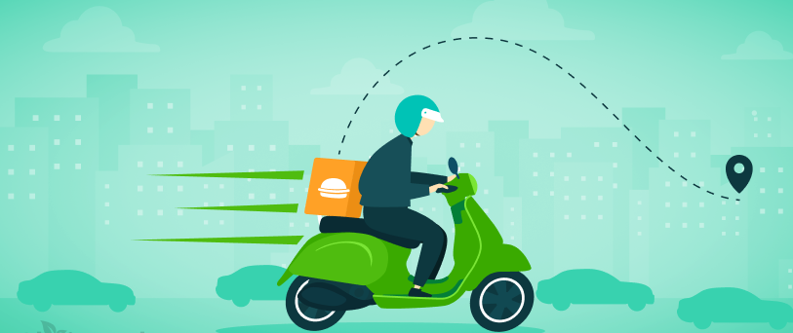
Food Delivery Time Predication
Guided by: Kanak
Submitted by: Jyothi P

Slide 2
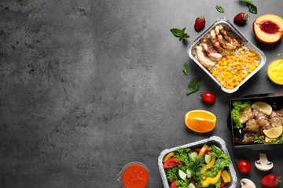
OUTLINE
>Introduction
>Problem Statement
>Dataset
>Python libraries
>Total columns
>Checking Null Values
>Calculating Distance Between Two Latitudes and Longitudes
>Data Exploration
>Relationship between distance and time taken
>Relationship between time taken and age
>Visualization with Graphs
>Time Predication
>Result
>Conclusion/Summary

Slide 3
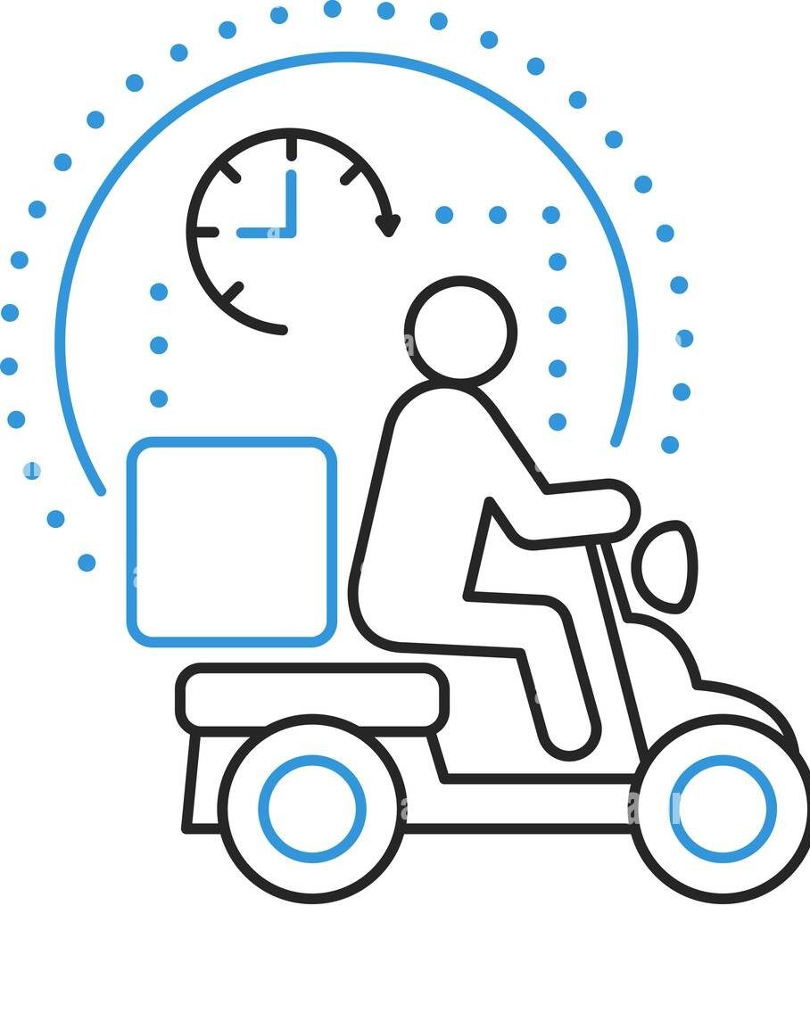
Introduction
Food Delivery services like Zomato and Swiggy need to show the accurate time it will take to deliver your order to keep transparency with their customers. These companies use Machine Learning
algorithms to predict the food delivery time based on how much time the delivery partners took for the same distance in the past

Slide 4
Libraries used
>import pandas as pd
>import numpy as np
>import plotly.express as px
>import keras

Slide 5
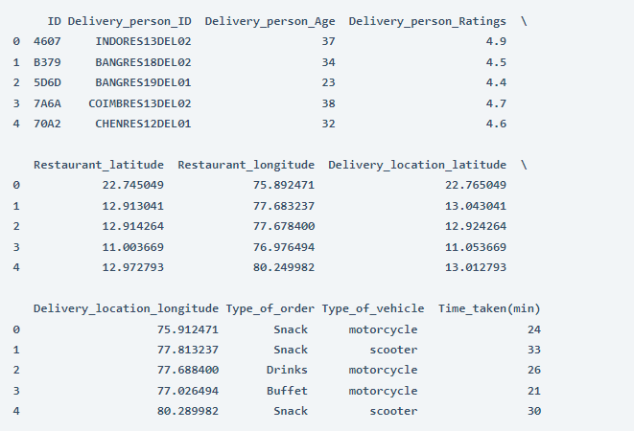
DataSet
data = pd.read_csv("deliverytime.txt")
print(data.head())

Slide 6
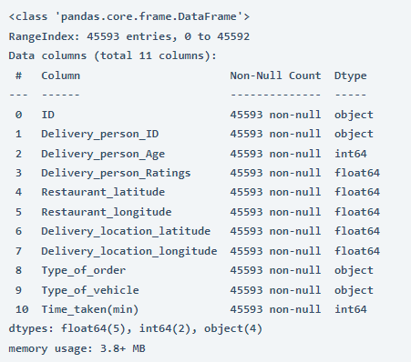
Column Included :
data.info()

Slide 7
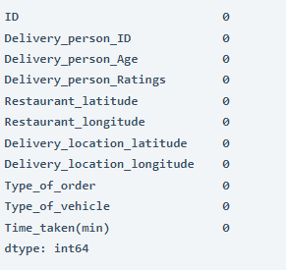
Checking Null values
data.isnull().sum()

Slide 8
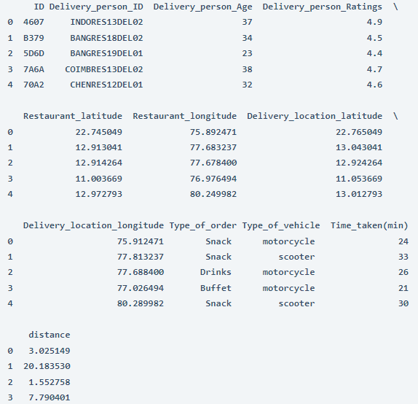
Haversine formula to calculate the distance between two locations based on their latitudes and longitudes.
print(data.head())

Slide 9
Data Exploration
Data Exploration to find relationships between the features.
figure = px.scatter(data_frame = data,
x="distance",
y="Time_taken(min)",
size="Time_taken(min)",
trendline="ols",
title = "Relationship Between Distance and Time Taken")
figure.show()

Slide 10
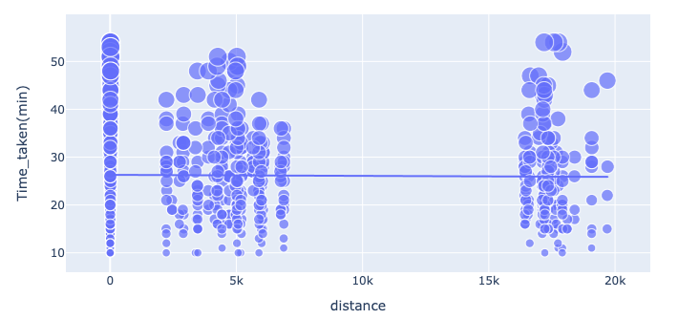
Relationship between distance and Time Taken
There is a consistent relationship between the time taken and the distance travelled to deliver the food. It means that most delivery partners deliver food within 25-30 minutes, regardless of distance

Slide 11
Relationship between the time taken to deliver the food and the age of the delivery partner:
figure = px.scatter(data_frame = data,
x="Delivery_person_Age",
y="Time_taken(min)",
size="Time_taken(min)",
color = "distance",
trendline="ols",
title = "Relationship Between Time Taken and Age")
figure.show()

Slide 12
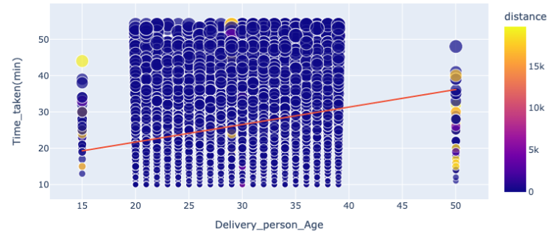
Relationship Between Time Taken and Age
There is a linear relationship between the time taken to deliver the food and the age of the delivery partner. It means young delivery partners take less time to deliver the food compared to the elder partners.

Slide 13
Relationship between the time taken to deliver the food and the ratings of the delivery partner:
figure = px.scatter(data_frame = data,
x="Delivery_person_Ratings",
y="Time_taken(min)",
size="Time_taken(min)",
color = "distance",
trendline="ols",
title = "Relationship Between Time Taken and Ratings")
figure.show()

Slide 14
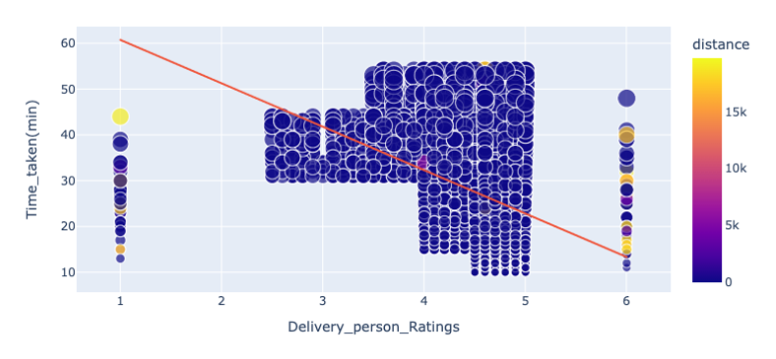
Relationship Between Time Taken and Rating

Slide 15
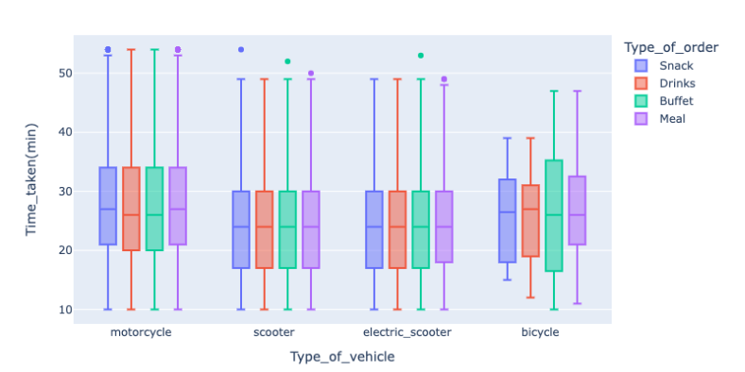
Checking if the type of food ordered by the customer and the type of vehicle used by the delivery partner affects the delivery time or not:

Slide 16
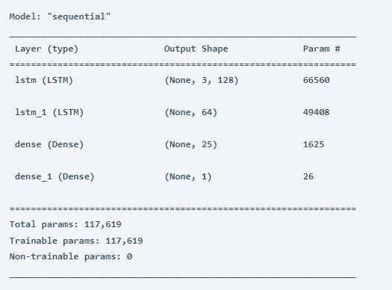
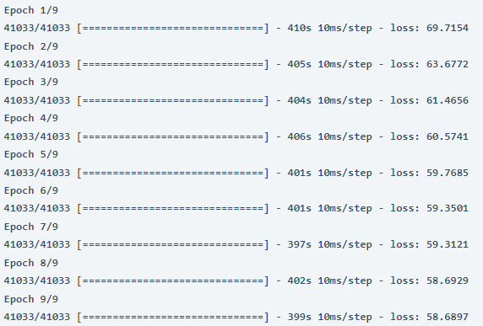
Using Machine Learning model for food delivery time prediction.
Food Delivery Time Prediction Model
>Machine learning uses the LSTM neural network model for the task of food delivery time prediction

Slide 17
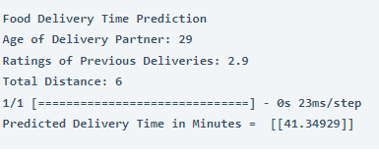
Performance of our model by giving inputs to predict food delivery time:
print("Food Delivery Time Prediction")
a = int(input("Age of Delivery Partner: "))
b = float(input("Ratings of Previous Deliveries: "))
c = int(input("Total Distance: "))
features = np.array([[a, b, c]])
print("Predicted Delivery Time in Minutes = ", model.predict(features))

Slide 18

Summary
To predict the food delivery time in real time, you need to calculate the distance between the food preparation point and the point of food consumption. After finding the distance between the restaurant and the delivery locations, you need to find relationships between the time taken by delivery partners to deliver the food in the past for the same distance.

Slide 19

Thank you!

